Slide 1
Better
Access Sheridan
Final Presentation - Group Project of SYST15892
Prepared for Professor Himanshu
Group Members
Daniel Ball, Minh Nguyen,
Nicholas Razack, Xingning Xu and Zawad Hossain

Slide 2
Project Background -
Better Access Sheridan
A semester long group project, where we had to work on our desired application bring about improvements within by applying the design principles we learnt in the course.

Slide 3
Vision -
Better Access Sheridan
Our goal is to improve our AccessSheridan web-portal.
A school’s web portal is a place where students distribute and receive information from professors.
It will also allows students/ professors and other Sheridan staffs to manage their courses, email, library resources, accounts and other essential features.

Slide 4
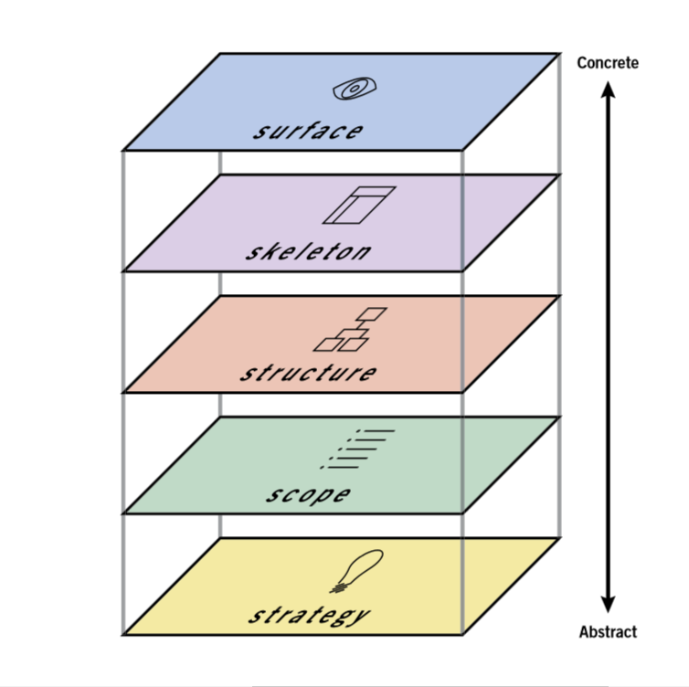
5 Planes of UX
Notes:
The iterative design process tells us to test repeatedly to build a good design(talk about the image the cycle) and increase the USABILITY of the design.

Slide 5
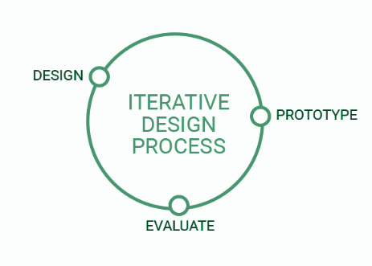
Iterative Design Process
Notes:
The iterative design process tells us to test repeatedly to build a good design(talk about the image the cycle) and increase the USABILITY of the design.

Slide 6
What is USER ExPERIENCE
?
How a User felt after using the product

Slide 7
What is USER CENTERED DESIGN
?
Design that meets a User’s requirements

Slide 8
Survey Responses
Notes:
To know the User requirements we carried out a survey and got 74 from our target audience

Slide 9
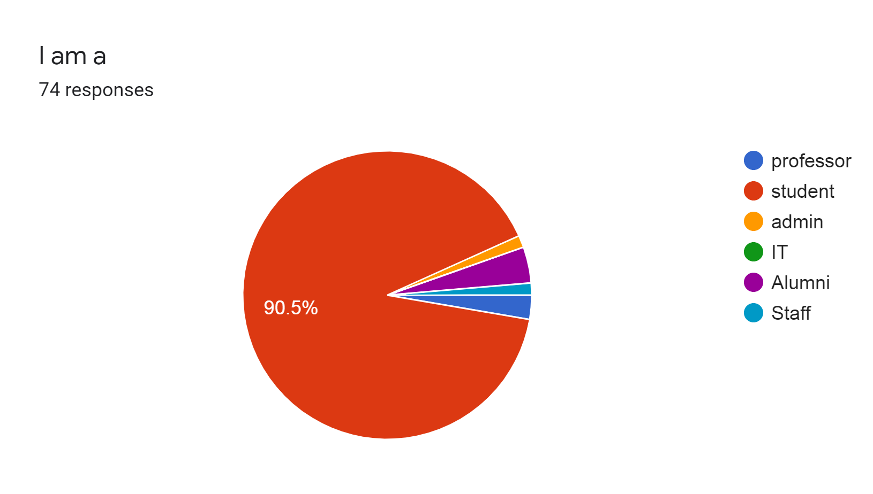
Our Target Audience
Total Respondents: 74

Slide 10
Survey Result Summary
60%
Poor experience
45%
Poor design
58/74
Wants a new look
0 Visit
Sheridan tv
Notes:
Summary of the result 45 % said a poor design 60% they had poor experience navigation
Out of 74 54 of them wants a new look.. There are features like Sheridan TV hardly anyone uses

Slide 11
Feedback From Survey
Easy Navigation
Modern look
Too crowded
Notes:
User requirements from the survey
Users had difficulty finding what they are looking for
Users complained about the interface which looks outdated
Users found the site crowded.

Slide 12
Initial Wireframes
WireFrame Pro
Notes:
Based on the Results of the survey we did our sketches and created wireframes of the protoype

Slide 13
Feedback From Survey
Easy Navigation
Modern look
Too crowded
Notes:
User requirements from the survey
Users had difficulty finding what they are looking for
Users complained about the interface which looks outdated
Users found the site crowded.

Slide 14
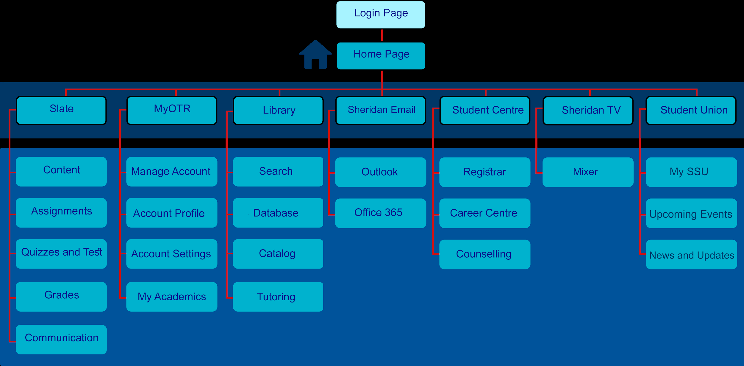
Hierarchy

Slide 15
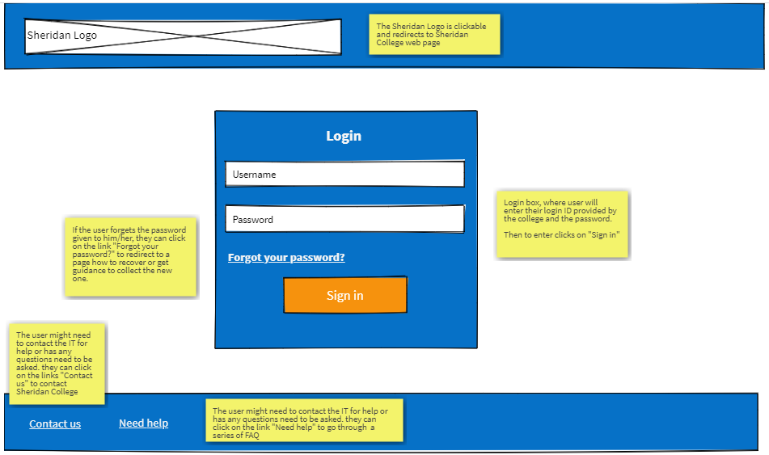
Login Page
Notes:
login page.
Simplified page
complementary color

Slide 16
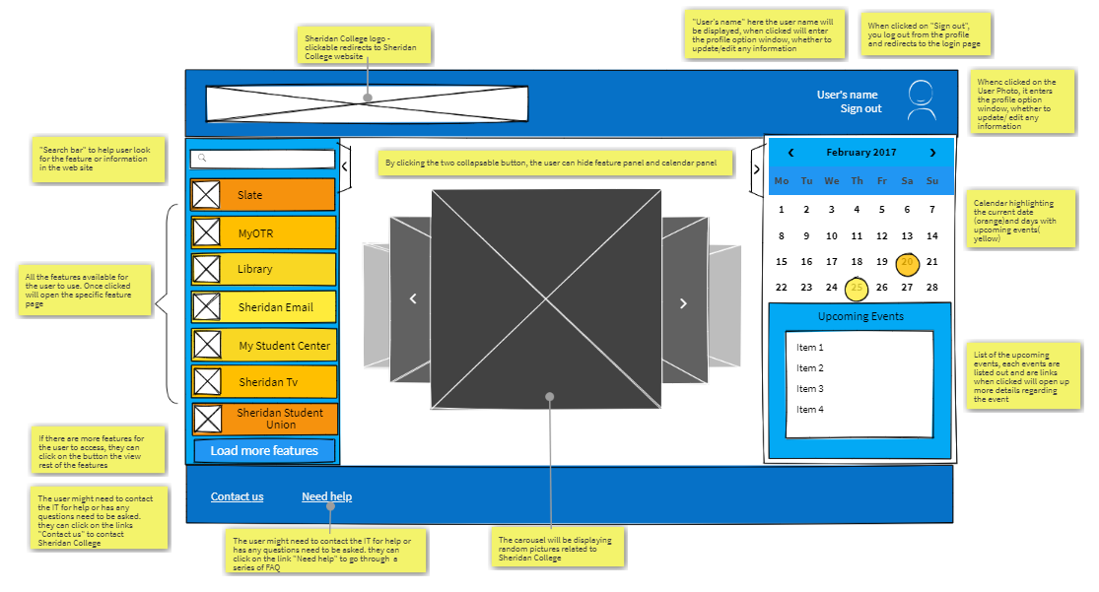
Landing Page
Home page after login
Notes:
Interface rules
Simplicity
Proximity
Clarity
Alignment
Additional feature-calendar

Slide 17
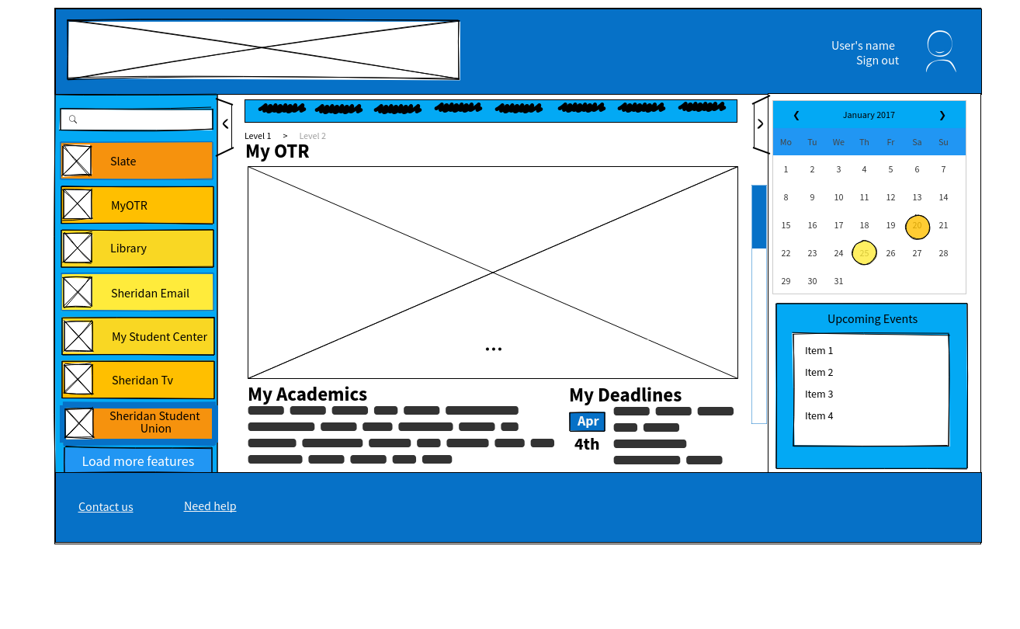
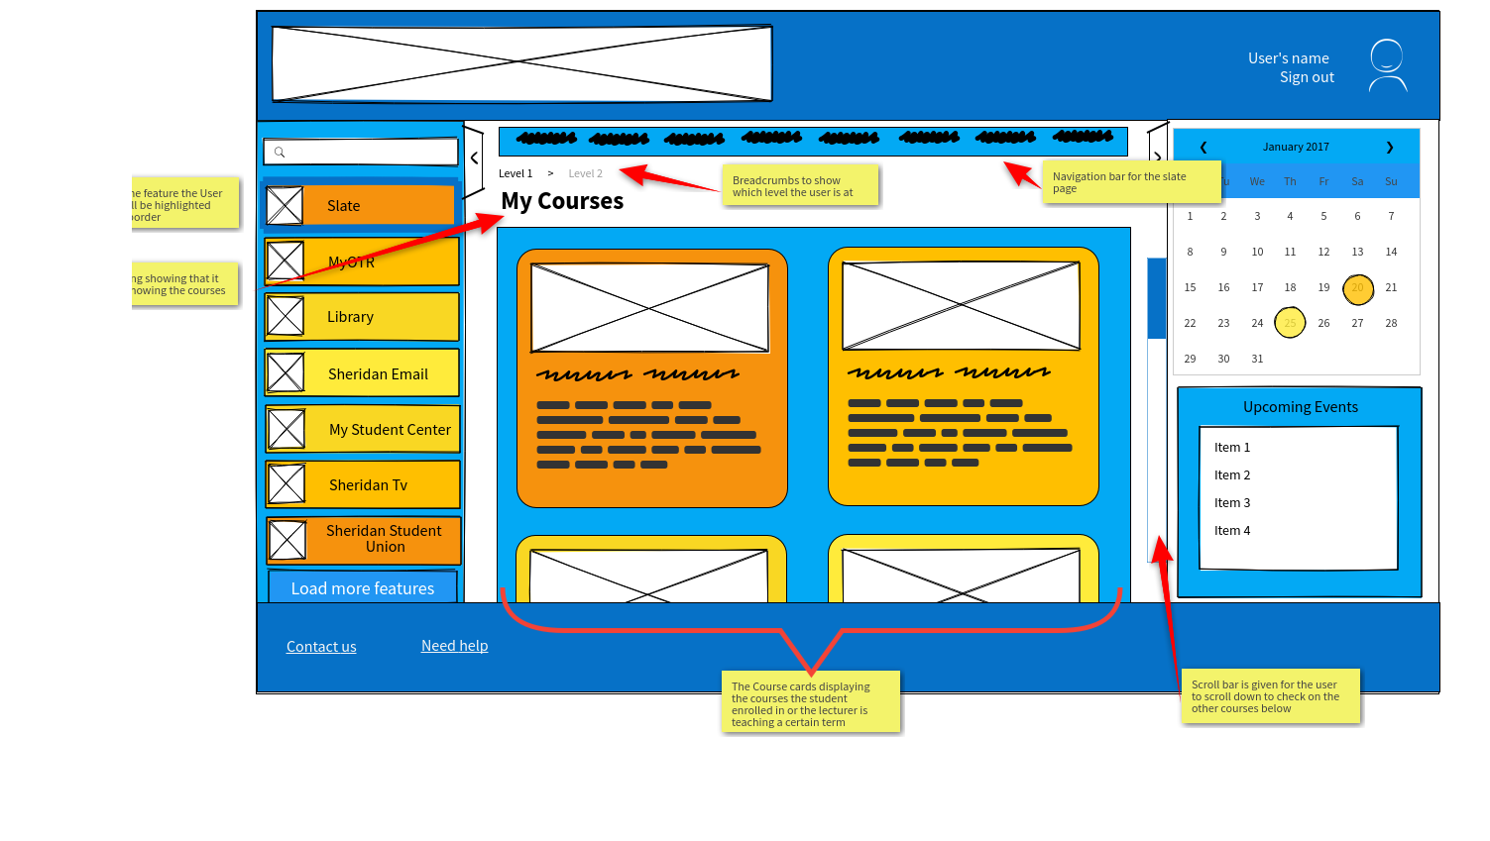
Other Pages
Notes:
Consistency

Slide 18
User Testing
Prototype Testing
Notes:
So as a group we chose 5 individuals and asked them to try out our prototype.

Slide 19
User Testing Result Summary
TASKS | RATINGS 1 easy 5 hard | USERS RATED
Please login (simple) | 1 | 1
Please go to SLATE page (simple) | 1 | 1
Please look for upcoming tests and assignments (advanced) | 3 | 1
Please check you student email (advanced) | 3 | 1.5
Please search for an item in the library’s catalogue (advanced) | 3 | 2
Notes:
We asked them to perform 5 tasks we ranked them and after the tests the users ranked them that is the average on the right. They shared their feedbacks which is on the next slide

Slide 20
User Feedbacks
Easy Navigation
Users found navigation easy and everything 1 click away
Modern look
Very simplistic approach.
Too crowded
Users found a bit clunky.
Confusing title
Use proper clear titles
Suggested to change color scheme
Notes:
The users found the prototype very easy to navigate, look was great except few issues like confused by titles and suggested strongly to change the color scheme.

Slide 21
Revised Wireframes
Adobe Illustrator

Slide 22
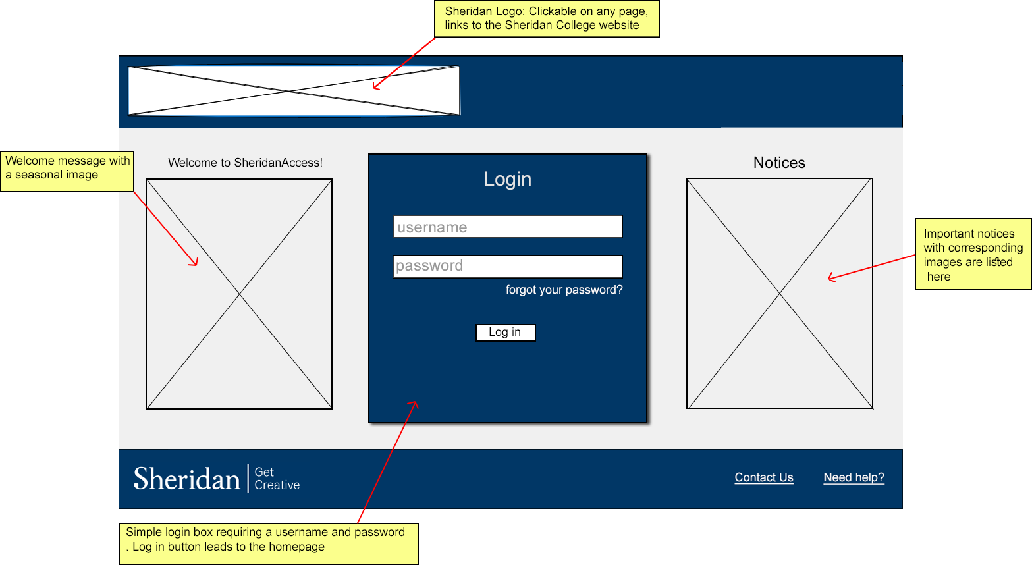
New Login
Page
Chose a darker color
Scheme as suggested
Notes:
Usrs suggested to make the login better by adding current information notices on the landing page

Slide 23
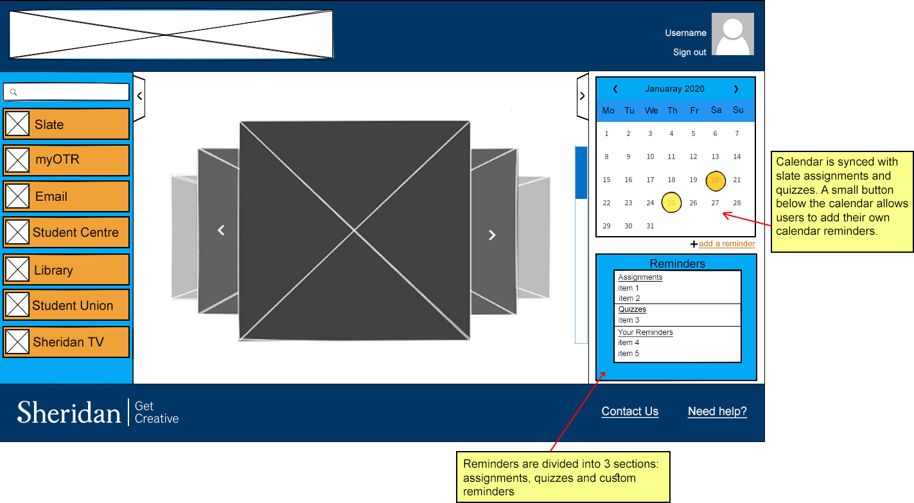
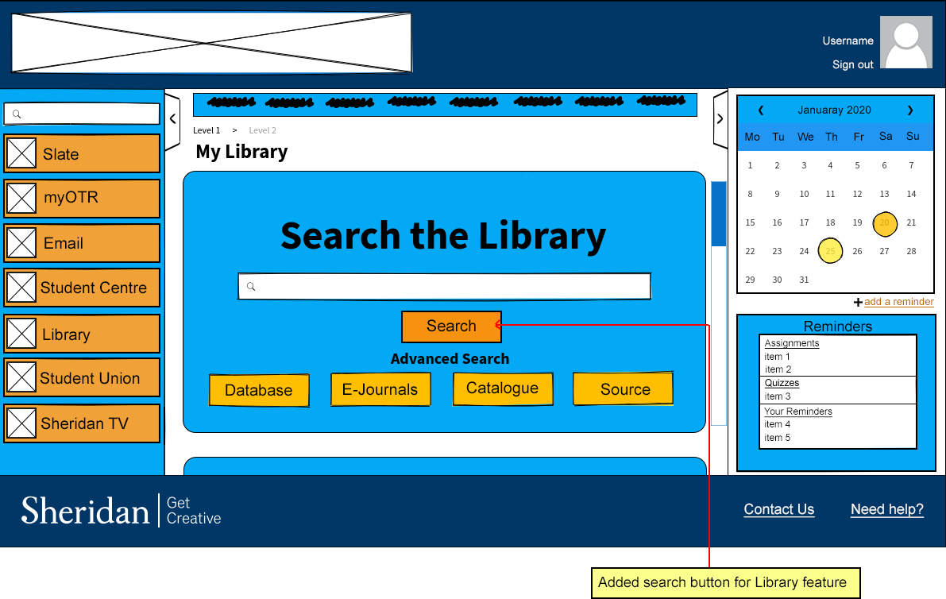
Other Pages
Notes:
We changed the color scheme as requested and added a search button to library page

Slide 24
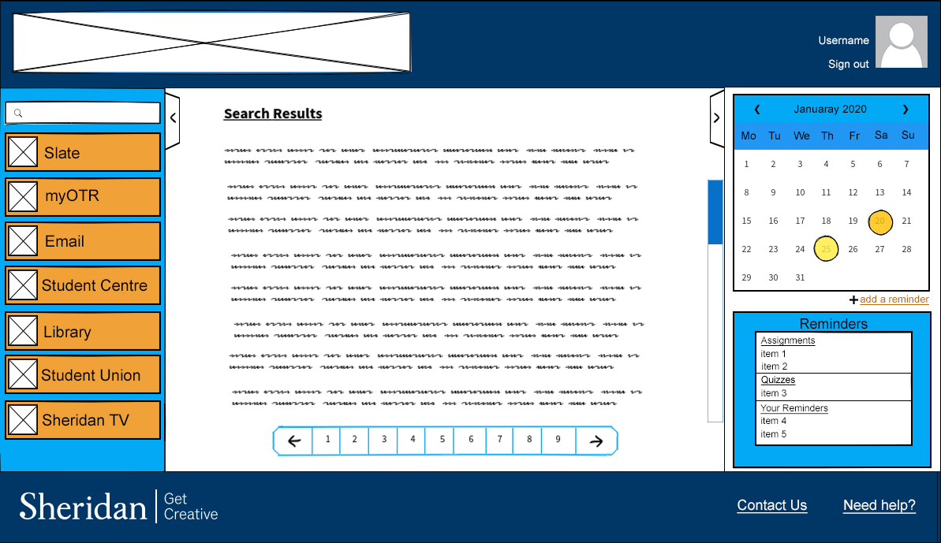
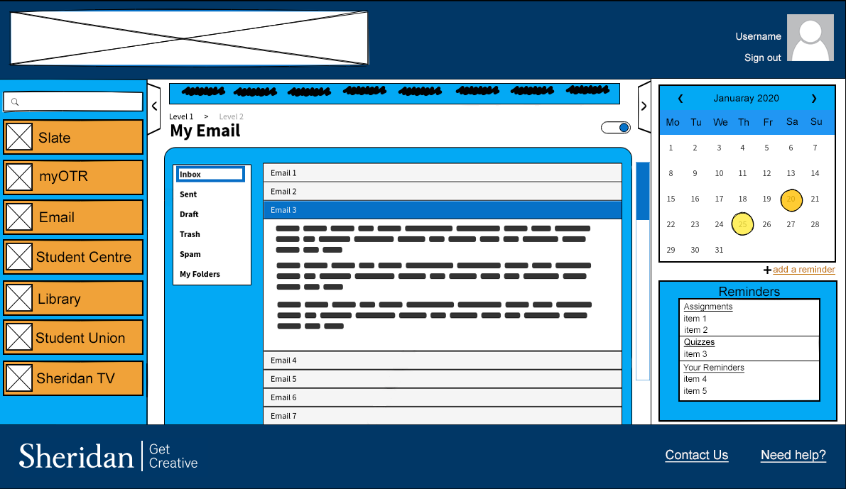
Other Pages
Notes:
All the remaining pages were fine simply changed the color scheme

Slide 25
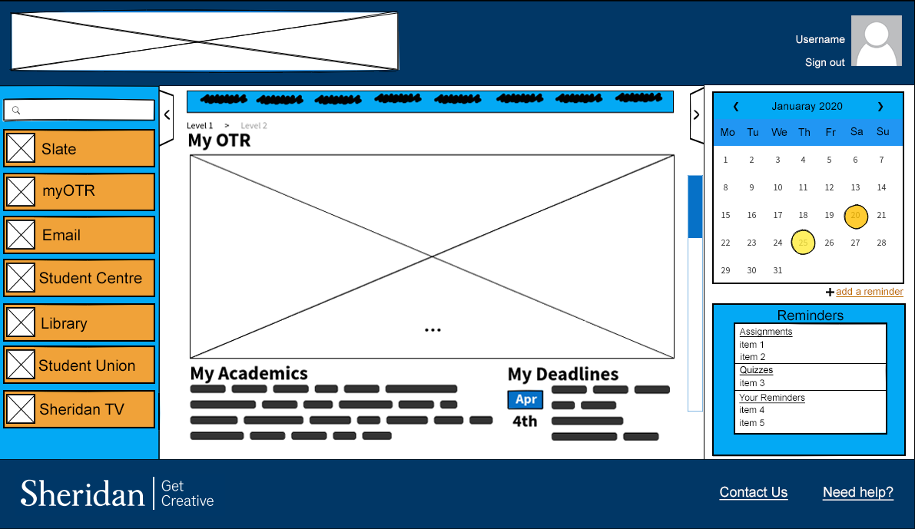
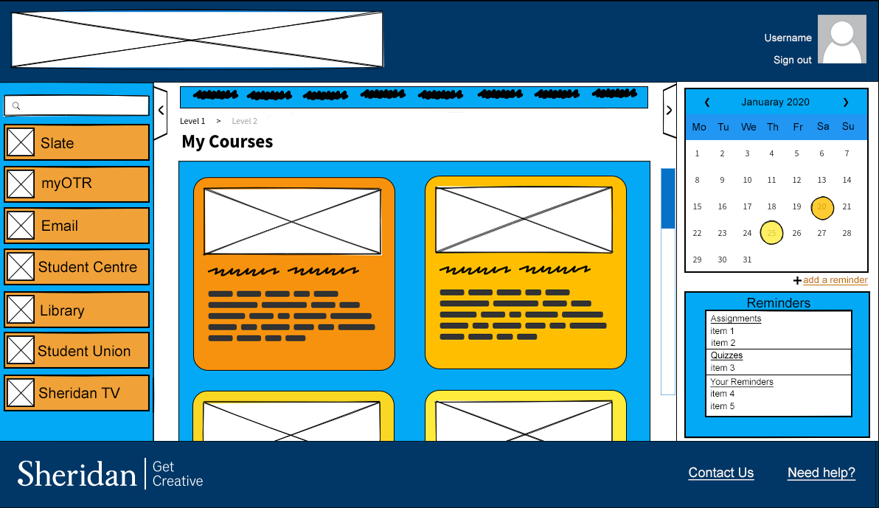
Other Pages
Notes:
MYOTr page and Slate remained the same in color.. We improved the calendar option by letting users to add their personal calendars

Slide 26
Learning Points
7 Interface Rules
5 Planes of UX Design
Color Theory
Typography
Pareto 80/20 principle
Iterative Design Process

Slide 27
Thank You
Better Access Sheridan

